Slide 1
Digital Image Processing
Image Enhancement

Slide 2
Contents
In this session we will look at spatial filtering techniques:
Neighbourhood operations
Linear vs Non-Linear Operations
What is spatial filtering?
What happens at the edges?
Smoothing linear operations
Simple non-linear operations
Unsharp masking

Slide 3
Neighbourhood Operations
Neighbourhood operations simply operate on a larger neighbourhood of pixels than point operations
Neighbourhoods are mostly a rectangle around a central pixel
Any size rectangle and any shape filter are possible
Origin
x
(x, y)
Neighbourhood
y
Image f (x, y)

Slide 4
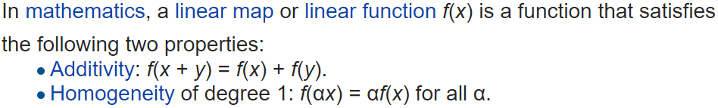
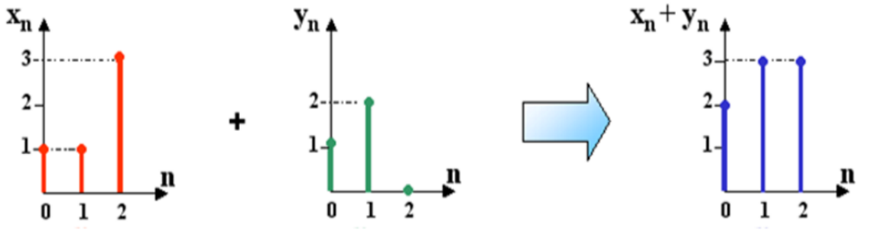
Linear vs Non Linear Filters
mean(Xn)+mean(Yn)=mean(Xn+Yn)
5/3+1=8/3 which is OK, so mean is linear function.
median(Xn)+median(Yn)=median(Xn+Yn),
1+1=3 which is not true, median is non linear.

Slide 5
Linear vs Non Linear Filters
Knowing which type of filter to select depends on the goals and nature of the image data.
In cases where the input data contains a large amount of noise but the magnitude is low, a linear low-pass filter (e.g., mean filter) may suffice.
Conversely, if an image contains a low amount of noise but with relatively high magnitude, then a non linear (e.g., median filter) may be more appropriate.

Slide 6
Simple Neighbourhood Operations Example
Original Image
x
Enhanced Image
x
123
127
128
119
115
130
140
145
148
153
167
172
133
154
183
192
194
191
194
199
207
210
198
195
164
170
175
162
173
151
y
y

Slide 7
The Spatial Filtering Process
Origin
x
a
b
c
r
s
t
d
e
f
*
u
v
w
g
h
i
x
y
z
Original Image Pixels
Filter
Simple 3*3 Neighbourhood
e
3*3 Filter
e_{processed} = v*e + r*a + s*b + t*c + u*d + w*f + x*g + y*h + z*i
y
Image f (x, y)
The above is repeated for every pixel in the original image to generate the filtered image

Slide 8
Spatial Filtering: Equation Form
Filtering can be given in equation form as shown above
Notes:
For convolution + is changed to – sign in equation.

Slide 9
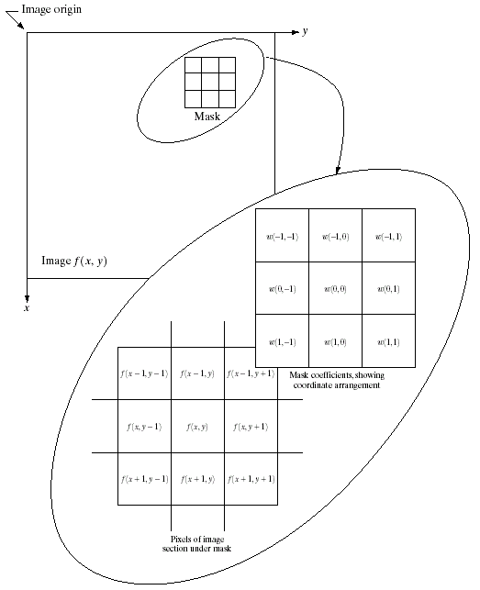
Spatial Filtering: Equation Form
Notes:
For convolution + is changed to – sign in equation.

Slide 10
Correlation & Convolution
The filtering we have been talking about so far is referred to as correlation with the filter itself referred to as the correlation kernel
Convolution is a similar operation, with just one subtle difference
For symmetric filters it makes no difference
a
b
c
r
s
t
e_{processed} = z*a + y*b + x*c + w*d + u*e + v*e + t*f + s*g + r*h
d
e
e
*
u
v
w
f
g
h
x
y
z
Original Image Pixels
Filter

Slide 11
Correlation & Convolution
Properties of Convolution
There are a number of important mathematical properties associated with convolution.
Convolution is commutative.
Convolution is associative.
Convolution is distributive.
where a, b, c, and d are all images, either continuous or discrete.

Slide 12
Strange Things Happen At The Edges!
At the edges of an image we are missing pixels to form a neighbourhood
Origin
x
e
e
e
e
e
e
e
y
Image f (x, y)

Slide 13
Strange Things Happen At The Edges! (cont…)
There are a few approaches to dealing with missing edge pixels:
Omit missing pixels
Only works with some filters
Can add extra code and slow down processing
Pad the image
Typically with either all white or all black pixels
Replicate border pixels
Truncate the image, only if borders are not important.
Allow pixels wrap around the image
Can cause some strange image artefacts

Slide 14
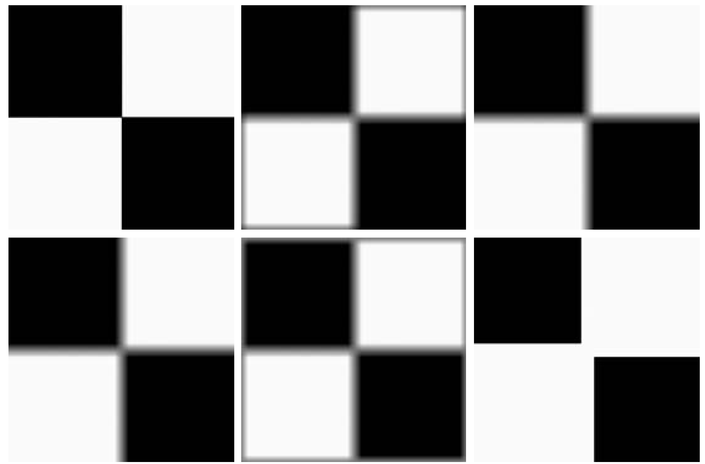
Strange Things Happen At The Edges! (cont…)
Filtered Image: Zero Padding
Original Image
Filtered Image: Replicate Edge Pixels
Filtered Image: Wrap Around Edge Pixels

Slide 15
Strange Things Happen At The Edges! (cont…)
Zero Padding

Slide 16
Strange Things Happen At The Edges! (cont…)
Replicate Edge Pixels

Slide 17
Strange Things Happen At The Edges! (cont…)
Wrap Around Edge Pixels

Slide 18
Smoothing Spatial Filters
One of the simplest spatial filtering operations we can perform is a smoothing operation
Simply average all of the pixels in a neighbourhood around a central value
Especially useful in removing noise from images
Also useful for highlighting gross detail
¹/₉ | ¹/₉ | ¹/₉
¹/₉ | ¹/₉ | ¹/₉
¹/₉ | ¹/₉ | ¹/₉
Simple averaging filter

Slide 19
Smoothing Spatial Filtering
Origin
x
104
100
108
¹/₉
¹/₉
¹/₉
99
106
98
*
¹/₉
¹/₉
¹/₉
95
90
85
¹/₉
¹/₉
¹/₉
Original Image Pixels
Filter
¹/₉
¹/₉
¹/₉
Simple 3*3 Neighbourhood
104
100
108
3*3 Smoothing Filter
¹/₉
¹/₉
¹/₉
99
106
98
¹/₉
¹/₉
¹/₉
95
90
85
e = ¹/₉*106 + ¹/₉*104 + ¹/₉*100 + ¹/₉*108 + ¹/₉*99 + ¹/₉*98 + ¹/₉*95 + ¹/₉*90 + ¹/₉*85
= 98.3333
y
Image f (x, y)
The above is repeated for every pixel in the original image to generate the smoothed image

Slide 20
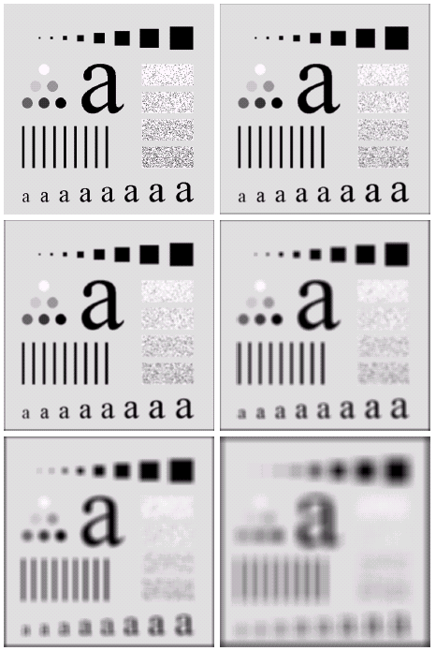
Image Smoothing Example
The image at the top left is an original image of size 500*500 pixels
The subsequent images show the image after filtering with an averaging filter of increasing sizes
3, 5, 9, 15 and 35
Notice how detail begins to disappear

Slide 21
Image Smoothing Example
Original Image

Slide 22
Image Smoothing Example
3x3 Average Filter

Slide 23
Image Smoothing Example
5x5 Average Filter

Slide 24
Image Smoothing Example
9x9 Average Filter

Slide 25
Image Smoothing Example
15x15 Average Filter

Slide 26
Image Smoothing Example
35x35 Average Filter

Slide 27
Weighted Smoothing Filters
More effective smoothing filters can be generated by allowing different pixels in the neighbourhood different weights in the averaging function
Pixels closer to the central pixel are more important
Often referred to as a weighted averaging
¹/₁₆ | ²/₁₆ | ¹/₁₆
²/₁₆ | ⁴/₁₆ | ²/₁₆
¹/₁₆ | ²/₁₆ | ¹/₁₆
Weighted averaging filter

Slide 28
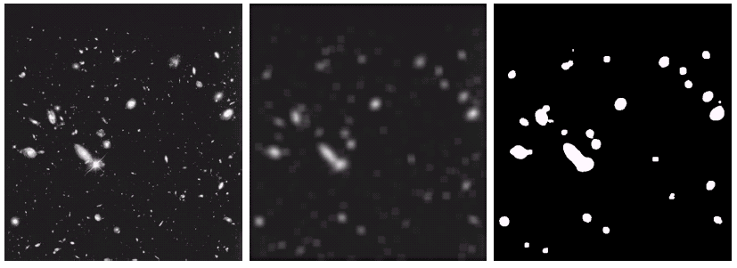
Another Smoothing Example
By smoothing the original image we get rid of lots of the finer detail which leaves only the gross features for thresholding
Original Image
Smoothed Image
Thresholded Image

Slide 29
Simple Non-Linear Operations
Some simple non linear neighbourhood operations include:
Min (erosion): Set the pixel value to the minimum in the neighbourhood
Max (dilation): Set the pixel value to the maximum in the neighbourhood
Median: The median value of a set of numbers is the midpoint value in that set (e.g. from the set [1, 7, 15, 18, 24] 15 is the median). Sometimes the median works better than the average

Slide 30
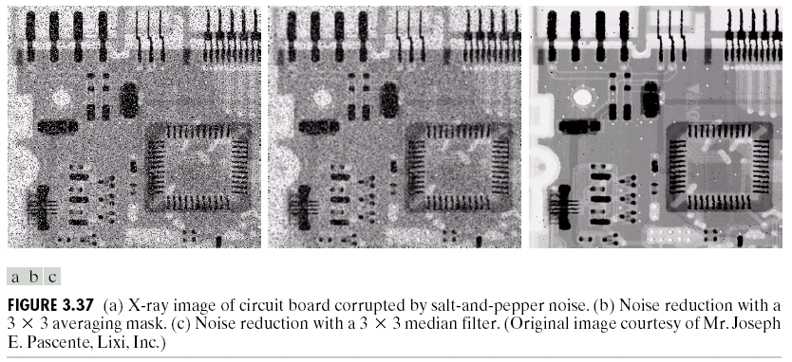
Averaging Filter Vs. Median Filter Example
Original Image With Noise
Image After Averaging Filter
Image After Median Filter
Filtering is often used to remove noise from images
Sometimes a median filter works better than an averaging filter

Slide 31
Averaging Filter Vs. Median Filter Example
Original Image

Slide 32
Averaging Filter Vs. Median Filter Example
Average Filter

Slide 33
Averaging Filter Vs. Median Filter Example
Median Filter

Slide 34
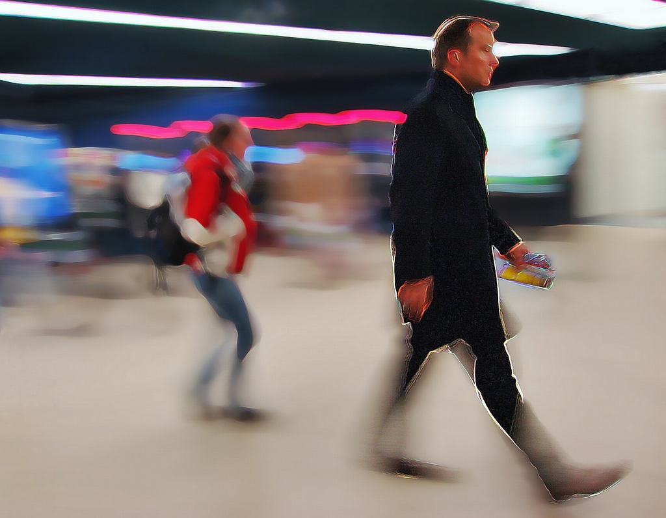
sharpen !
Unlike smoothing the principal objective of sharpening is to highlight transition in intensity.
http://flickr.com/photos/t_schnitzlein/87607390/
Notes:
eagle coin http://www.flickr.com/photos/samfeinstein/1190290008/

Slide 35
unsharp masking
Unsharp masking is an image manipulation technique for increasing the apparent sharpness of photographic images.
The "unsharp" of the name derives from the fact that the technique uses a blurred, or "unsharp", positive to create a "mask" of the original image. The unsharped mask is then combined with the negative, creating a resulting image sharper than the original.
Steps
Blur the image
Subtract the blurred version from the original (this is called the mask)
Add the “mask” to the original
Notes:
http://en.wikipedia.org/wiki/Unsharp_masking
http://flickr.com/photos/66092621@N00/37208856/

Slide 36
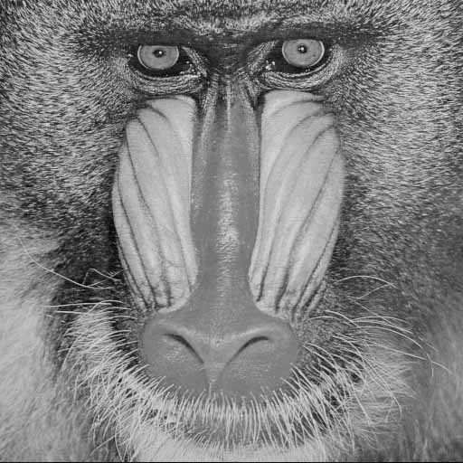
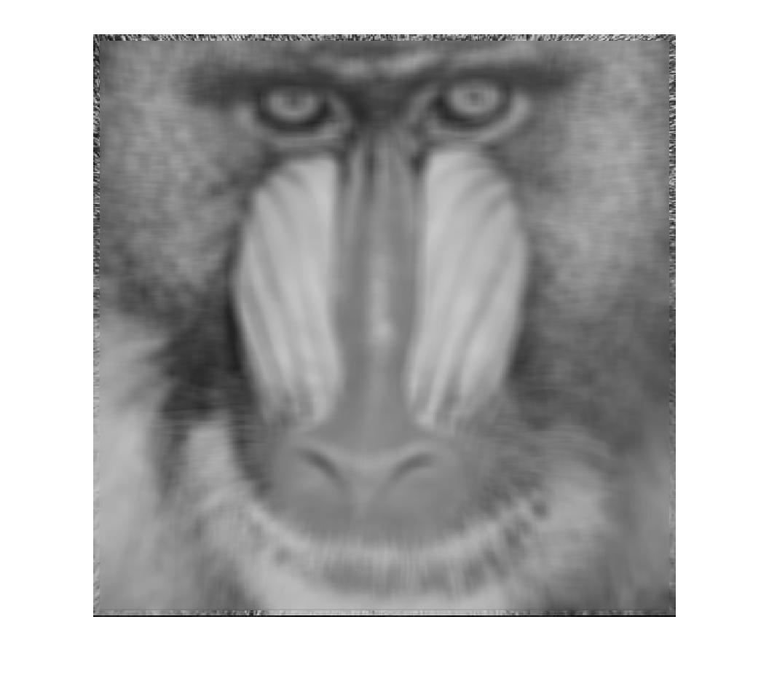
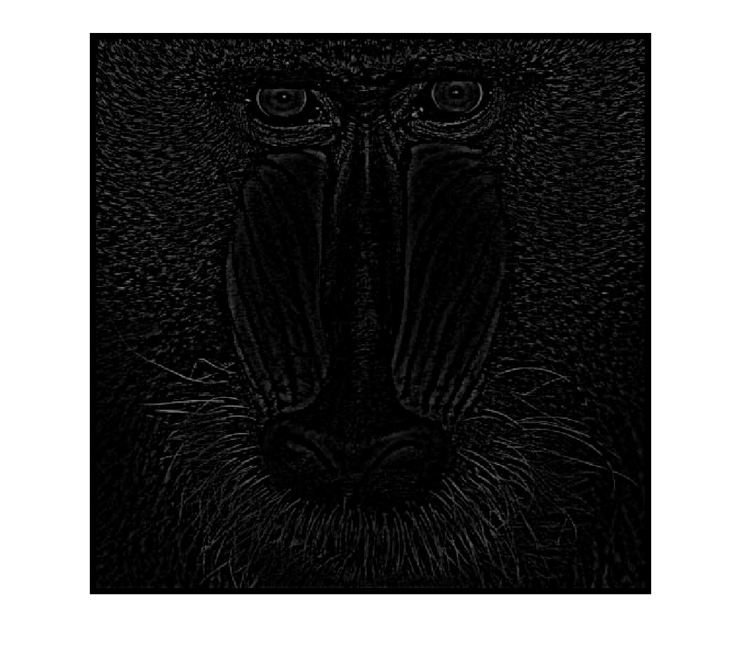
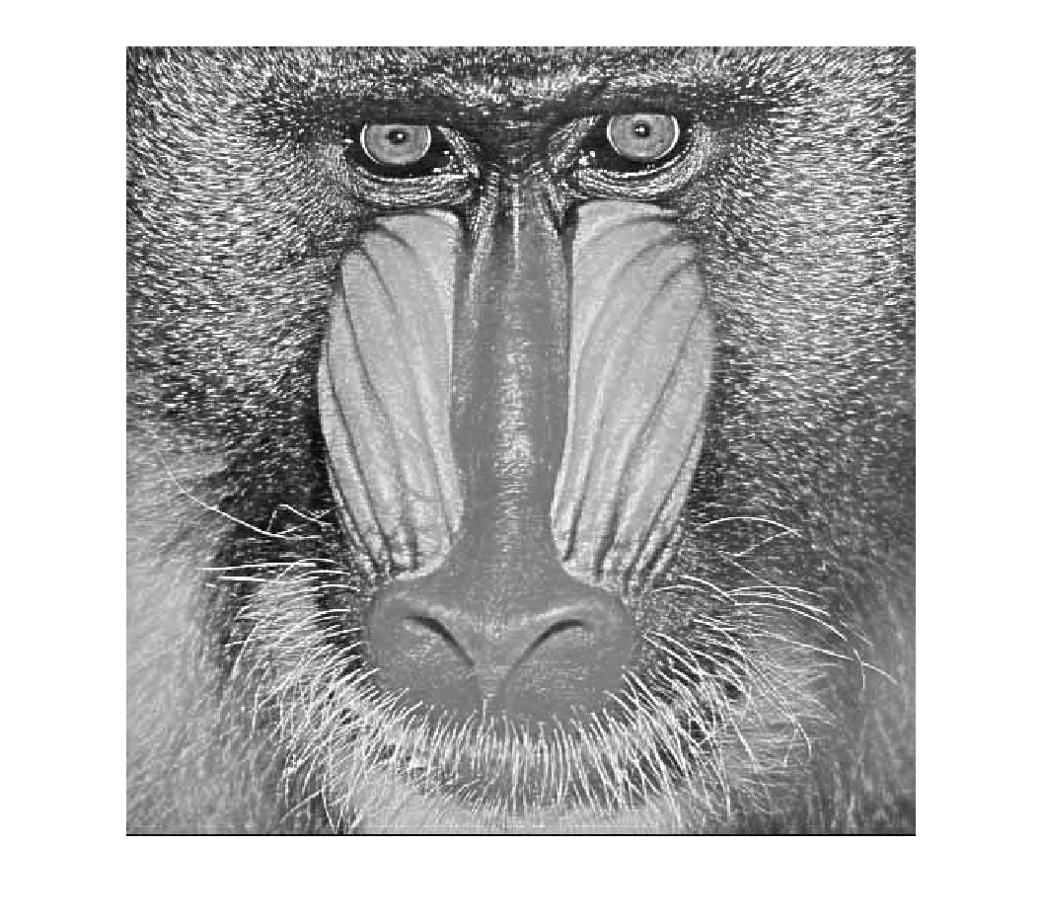
high-boost filtering
Avg.
₋
₊
Let f’(x) is the blurred image.
Unsharp mask:
high-boost with A=1
₊

Slide 37
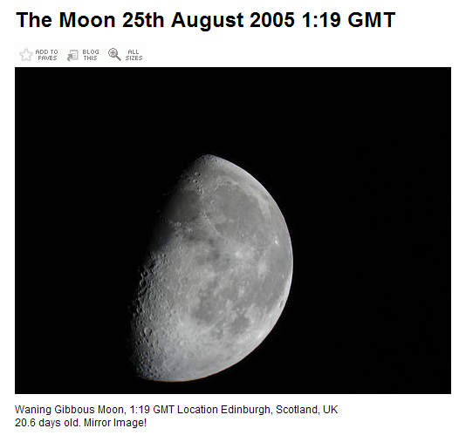
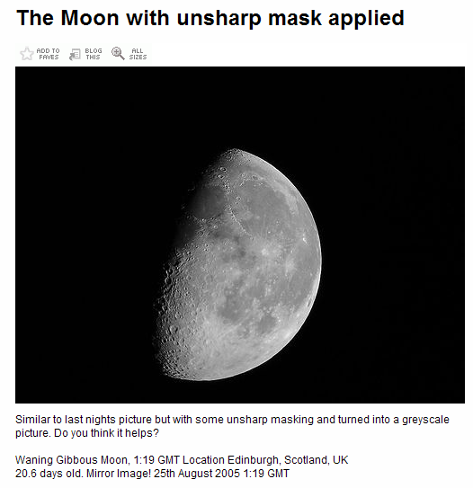
unsharp mask example

Slide 38
Summary
In this lecture we have looked at the idea of spatial filtering and in particular:
Neighbourhood operations
The filtering process
Smoothing filters
Dealing with problems at image edges when using filtering
Unsharp Masking
Next time we will look at sharpening filters using image derivatives as well as more on filtering and image enhancement

